Slide 1


An Autonomous Institute
Affiliated to VTU, Belagavi,
Approved by AICTE, New Delhi,
Recognized by UGC with 2(f) & 12(B)
Accredited by NBA & NAAC
ECOVISION – AN AI POWERED WASTE DETECTION SYSTEM
NATIONAL CADET CORPS – MVJ22A6YY3
ANANYA KAMATH S - 1MJ23IS006
HEMA SATHVIKA V - 1MJ23IS027
RISHIKESH TALE - 1MJ23IS064
POOJA R -1MJ23CH009
An Autonomous Institution ,Affiliated to Visvesvaraya Technological University, Belagavi. Approved By AICTE, New Delhi. Recognized by UGC with 2(f) & 12(B) status. Accredited by NBA and NAAC.

Slide 2
CONTENTS
INTRODUCTION
OBJECTIVES
METHODOLOGY
WORKING PROCESS
MATERIALS USED
RESULTS
CONCLUSION

Slide 3
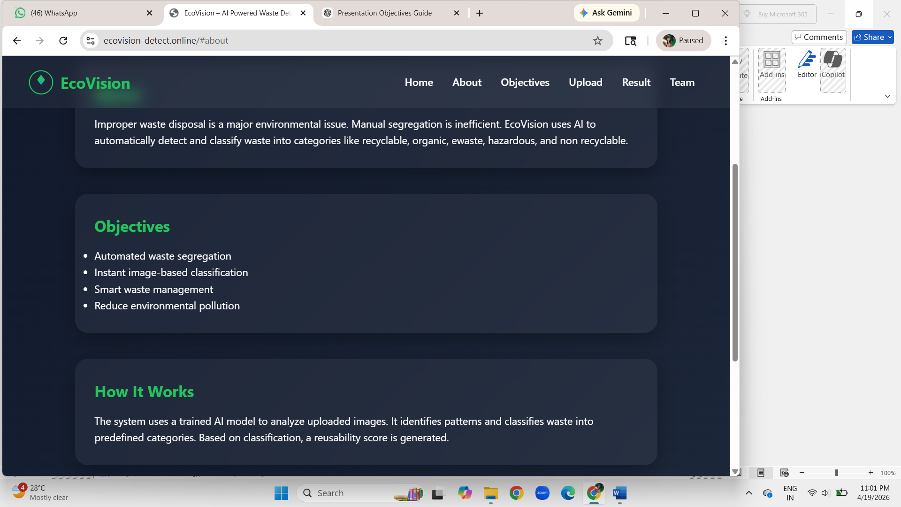
INTRODUCTION
Waste management is a major environmental issue
Manual sorting is slow and error-prone
Improper segregation reduces recycling efficiency
AI can automate waste classification
EcoVision provides a smart solution

Slide 4
OBJECTIVES
Automated Waste Segregation
Real-time classification
Reusability scoring
Edge-based implementation
Smart waste management

Slide 5
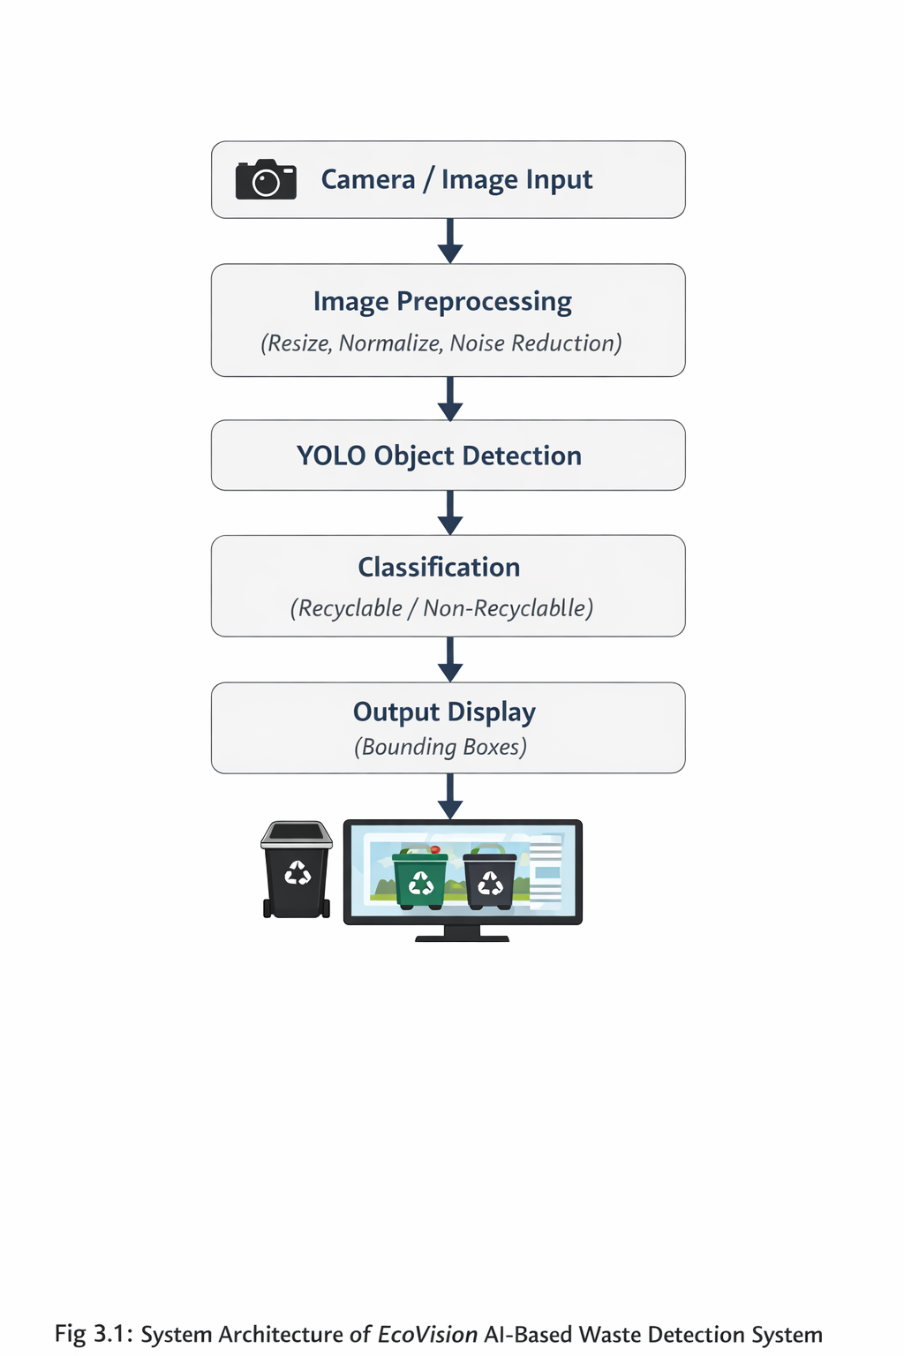
METHODOLOGY
Step 1: Data Collection
Step 2: Data Preprocessing
Step 3: Model Selection & Training
Step 4: Waste Detection & Classification
Step 5: Reusability Score Calculation
Step 6: Edge Deployment
Step 7: Output & Smart Sorting

Slide 6
WORKING PROCESS
Uses Python + OpenCV
YOLO model for object detection
Image processed in real-time
Bounding boxes generated

Slide 7
MATERIALS USED
Software:
Python
OpenCV
YOLO
TensorFlow / PyTorch

Slide 8
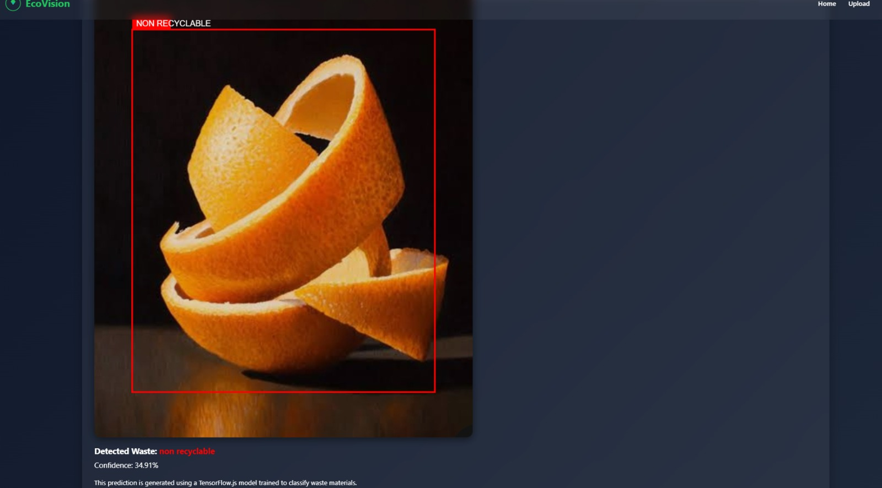
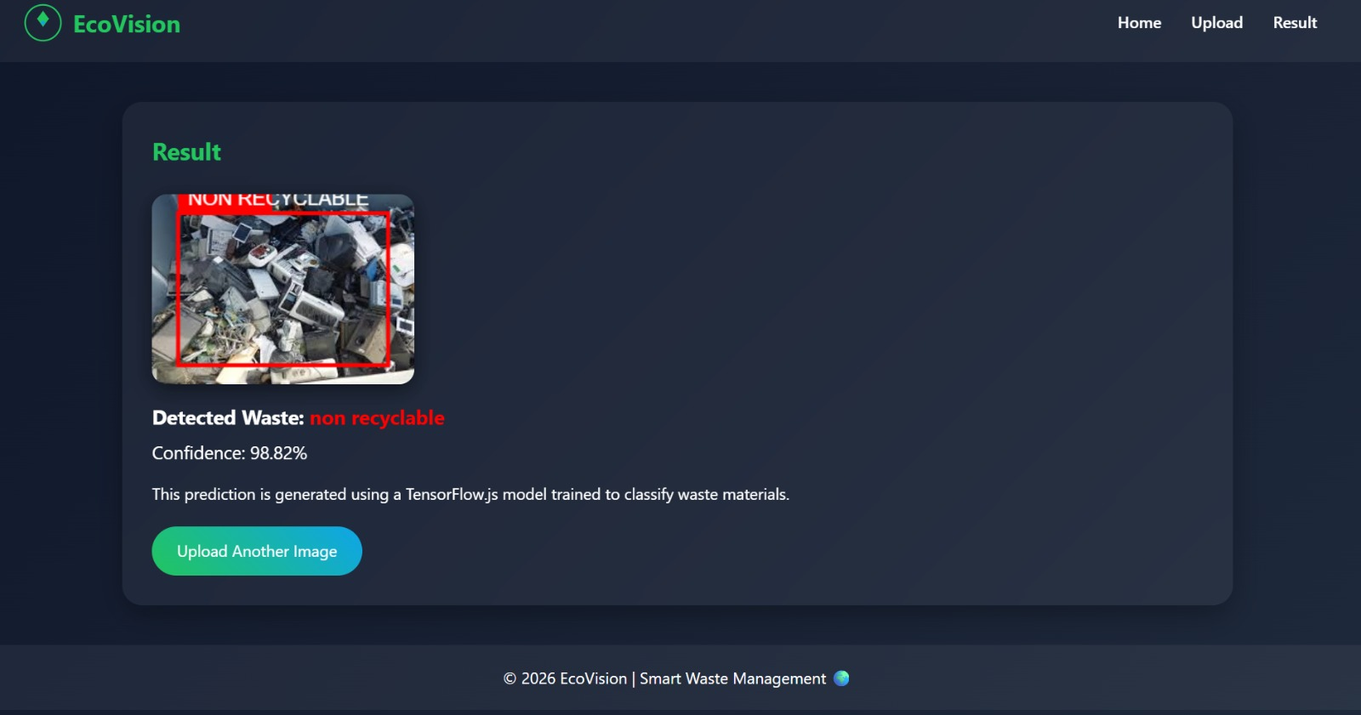
RESULTS

Slide 9
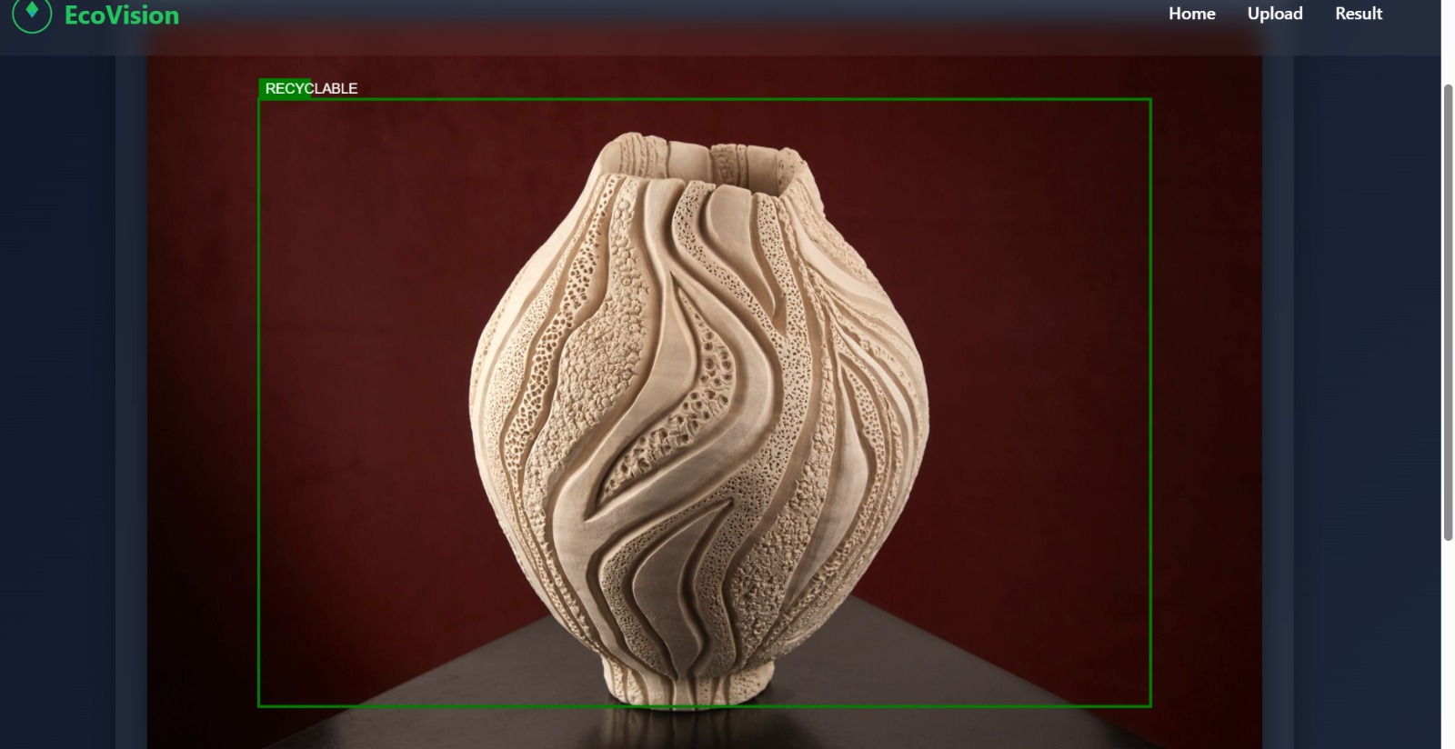
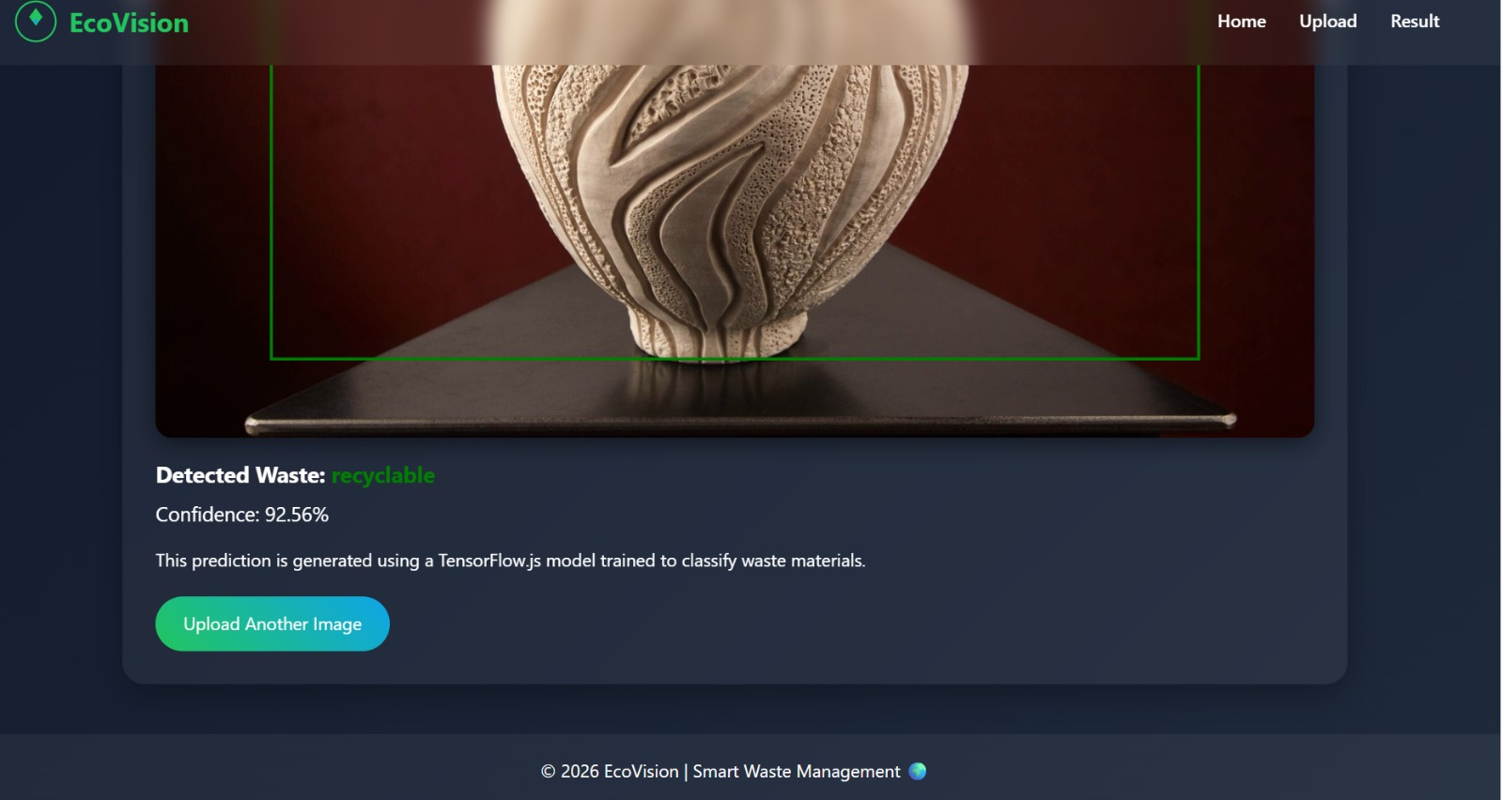

Slide 10
CONCLUSION
AI-based system for smart waste segregation
Accurate real-time detection using YOLO
Reduces human effort and errors
Improves recycling efficiency
Supports sustainable and smart city solutions

Slide 11
THANK YOU

